Slide 1
SOFTWARE PROJECT MANAGEMENT BIT 2215
Edwin Kimathi SCT221-0762/2021
Daisy Chemutai SCT221-0849/2021 Elizabeth Wanyama SCT221-0106/2021

Slide 2
Technologies used
JavaScript
HTML
CSS
Bootstrap

Slide 3
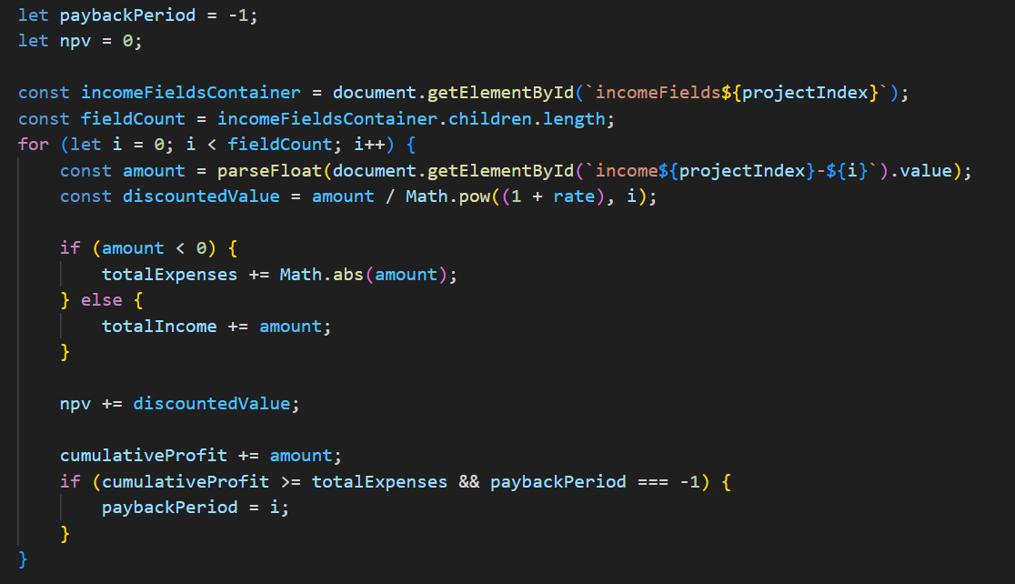
Financial Methods a) Payback Method
Measures how long it will take to return project investment.

Slide 4
ROI
Measures how much we get back for each shs invested
AP = Incomes – Expenses/ project duration
ROI = AP/Expenses )%

Slide 5
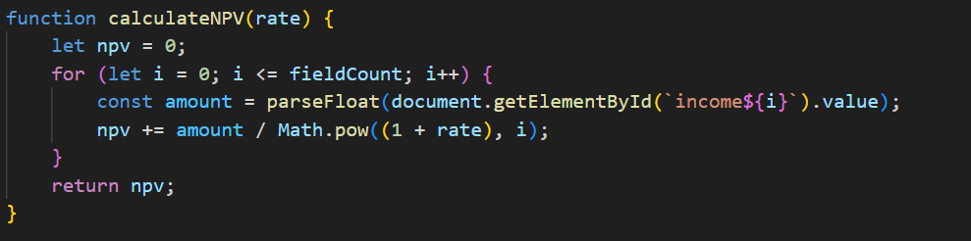
NPV
Takes into account the inflation rate to get the current value of shs invested.

Slide 6
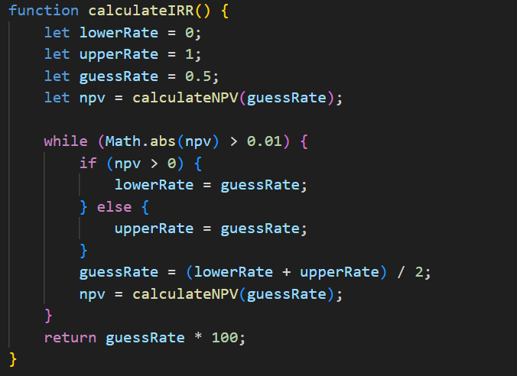
IRR
Rate at which the NPV of future cash flow = 0

